Slide 1


The most intelligent automated system for recruiting blood donors

Slide 2
Every 2sec someone needs blood
90% of people eligible to donate blood are not doing so
Almost 80% agree to donate if they be asked
http://www.redcrossblood.org/learn-about-blood/blood-facts-and-statistics
http://www.euro.who.int/en/health-topics/Health-systems/blood-safety/data-and-statistics

Slide 3
Problems
Lack of first-time donors almost all over the world.
A complex and inefficient process of recruiting donors.

Slide 4
Solution
Automated system based on social media monitoring and AI messenger bots

Slide 5


Udonors
Social networks
monitoring MVP stage
Bot platform
R&D stage
Knowledge system (DonorUA) Done!

Slide 6
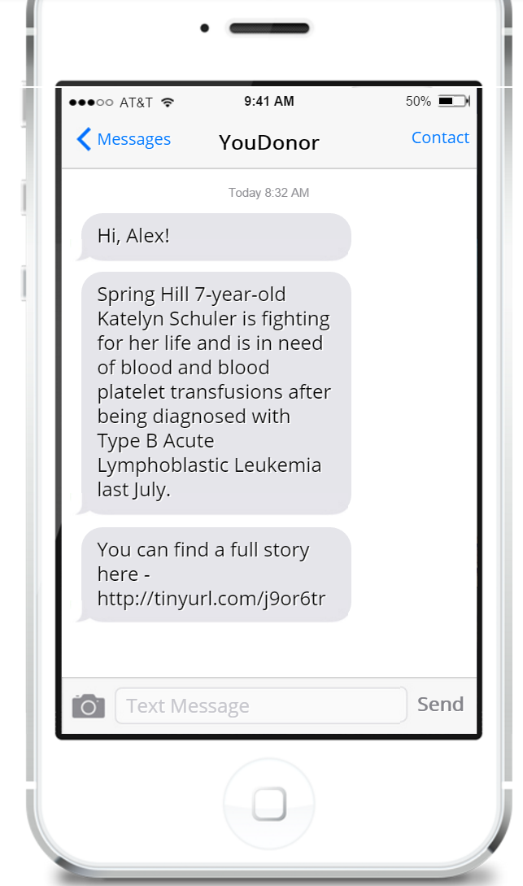
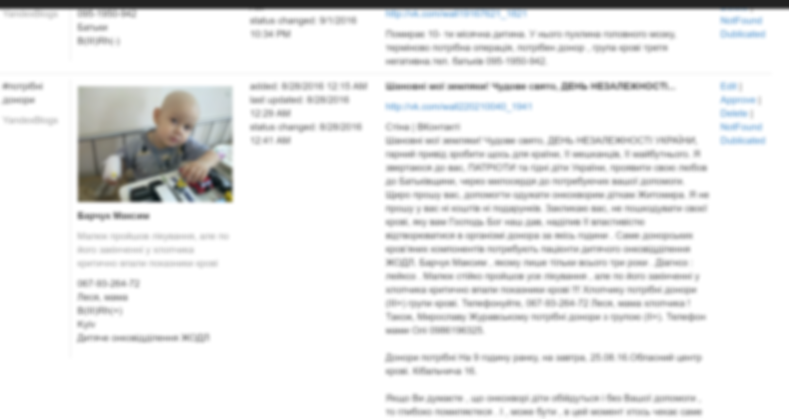
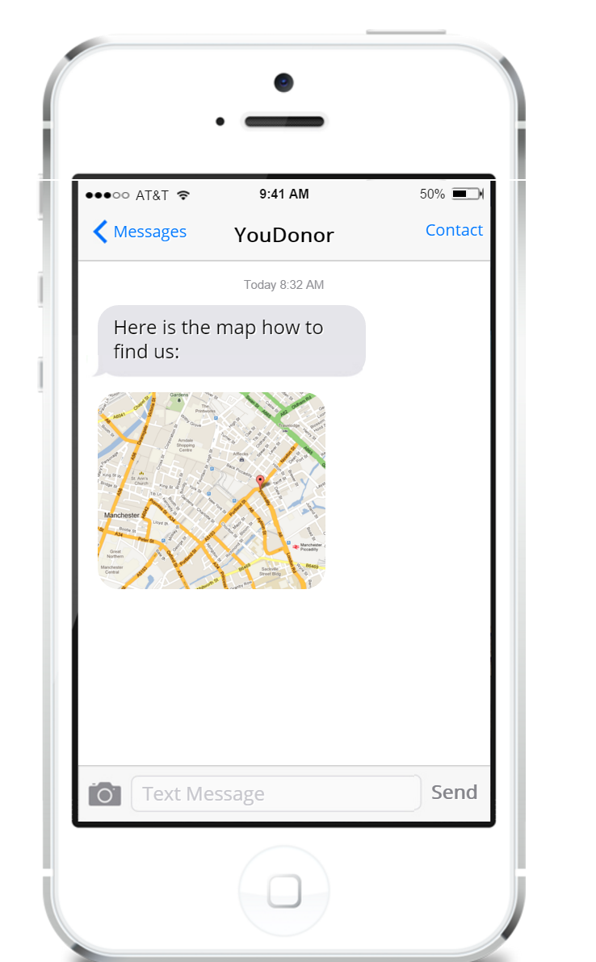
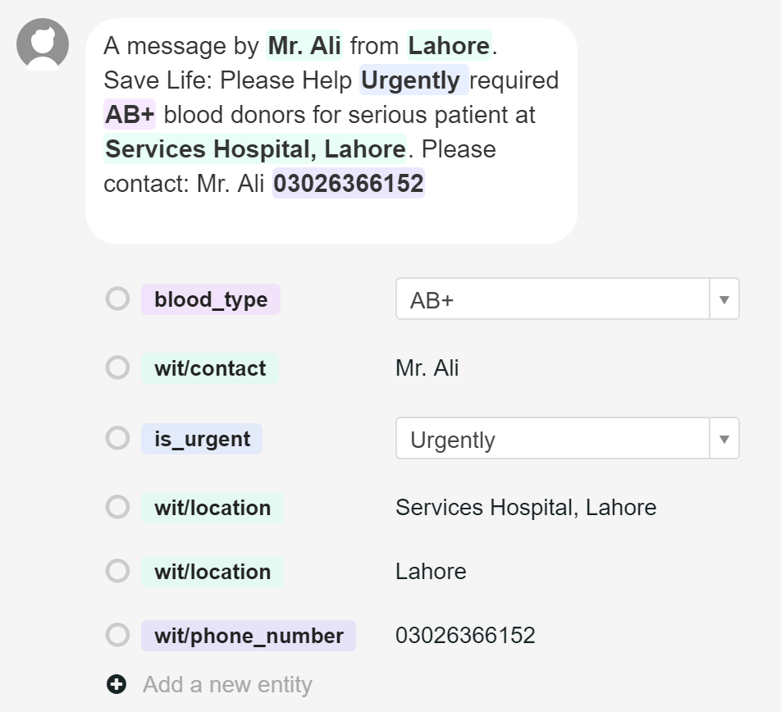
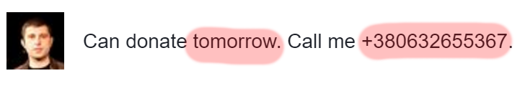
How it works

Slide 7
Traction (October, 2016)
7100+ registered blood donors
600+ recipients
600+ requests for searching donors
4500+ donations
20-60 minutes takes to find blood donor for selected cases in Ukraine

Slide 8
Business Model
Software licensing. Direct sales to government and private health institutions, NGOs.
Subscription model for donors and health institutions.

Slide 9
Industry Statistics & Market Size
36,000
Units of red blood cells are needed every day in the U.S.
$24bn
Annual revenue
2.8%
Annual growth
Blood & Organ Banks Market Research Report | NAICS 62199 | Oct 2015
http://www.ibisworld.com/industry/default.aspx?indid=1582

Slide 10
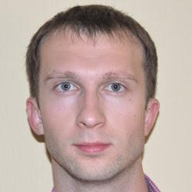
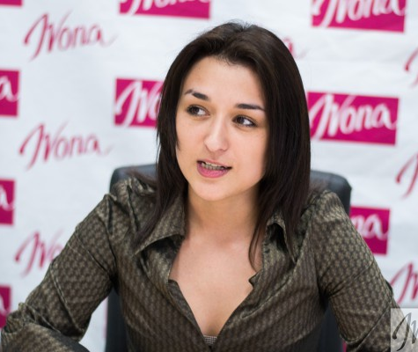
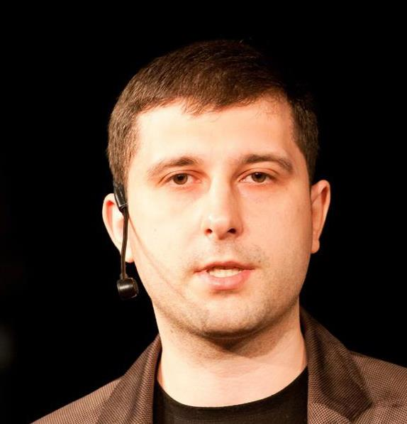
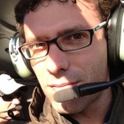
Team
Iryna Slavinska
Co-founder
President at All-Ukrainian youth NGO “Association of young blood donors of Ukraine”
Oleksandr Krakovetskyi
CEO, Co-founder
CEO DevRain Solutions.
Microsoft Regional Director
PhD in Computer Science
Mihail Galushko
Co-founder
CTO DevRain Solutions
Microsoft Most Valuable Professional
Diego de Jódar Advisor
Passionate problem solver with +15 Years of experience working at the intersection of Marketing & Product

Slide 11
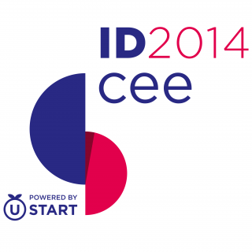






Awards and visibility
The winner of hackhaton SocialBoost at IDCEE conference 2014.
The best technological solution in social projects sphere
and NGOs within the contest from GURT (www.gurt.org.ua)
and Microsoft Ukraine
The winner of Stockholm Startup Weekend: Social Innovation 2016
More than 100 references in the media and TV

Slide 12
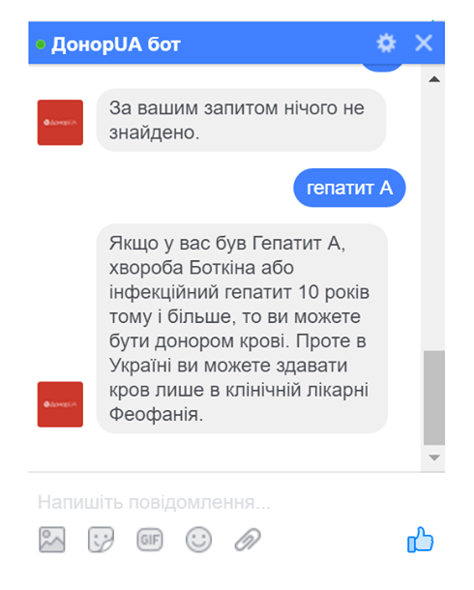
Progress
Winner of “Ukraine is looking for startups” competition.
Bot assistant for Telegram, Skype, Facebook Messenger, email, web is announced!
https://donor.ua/bot

Slide 13
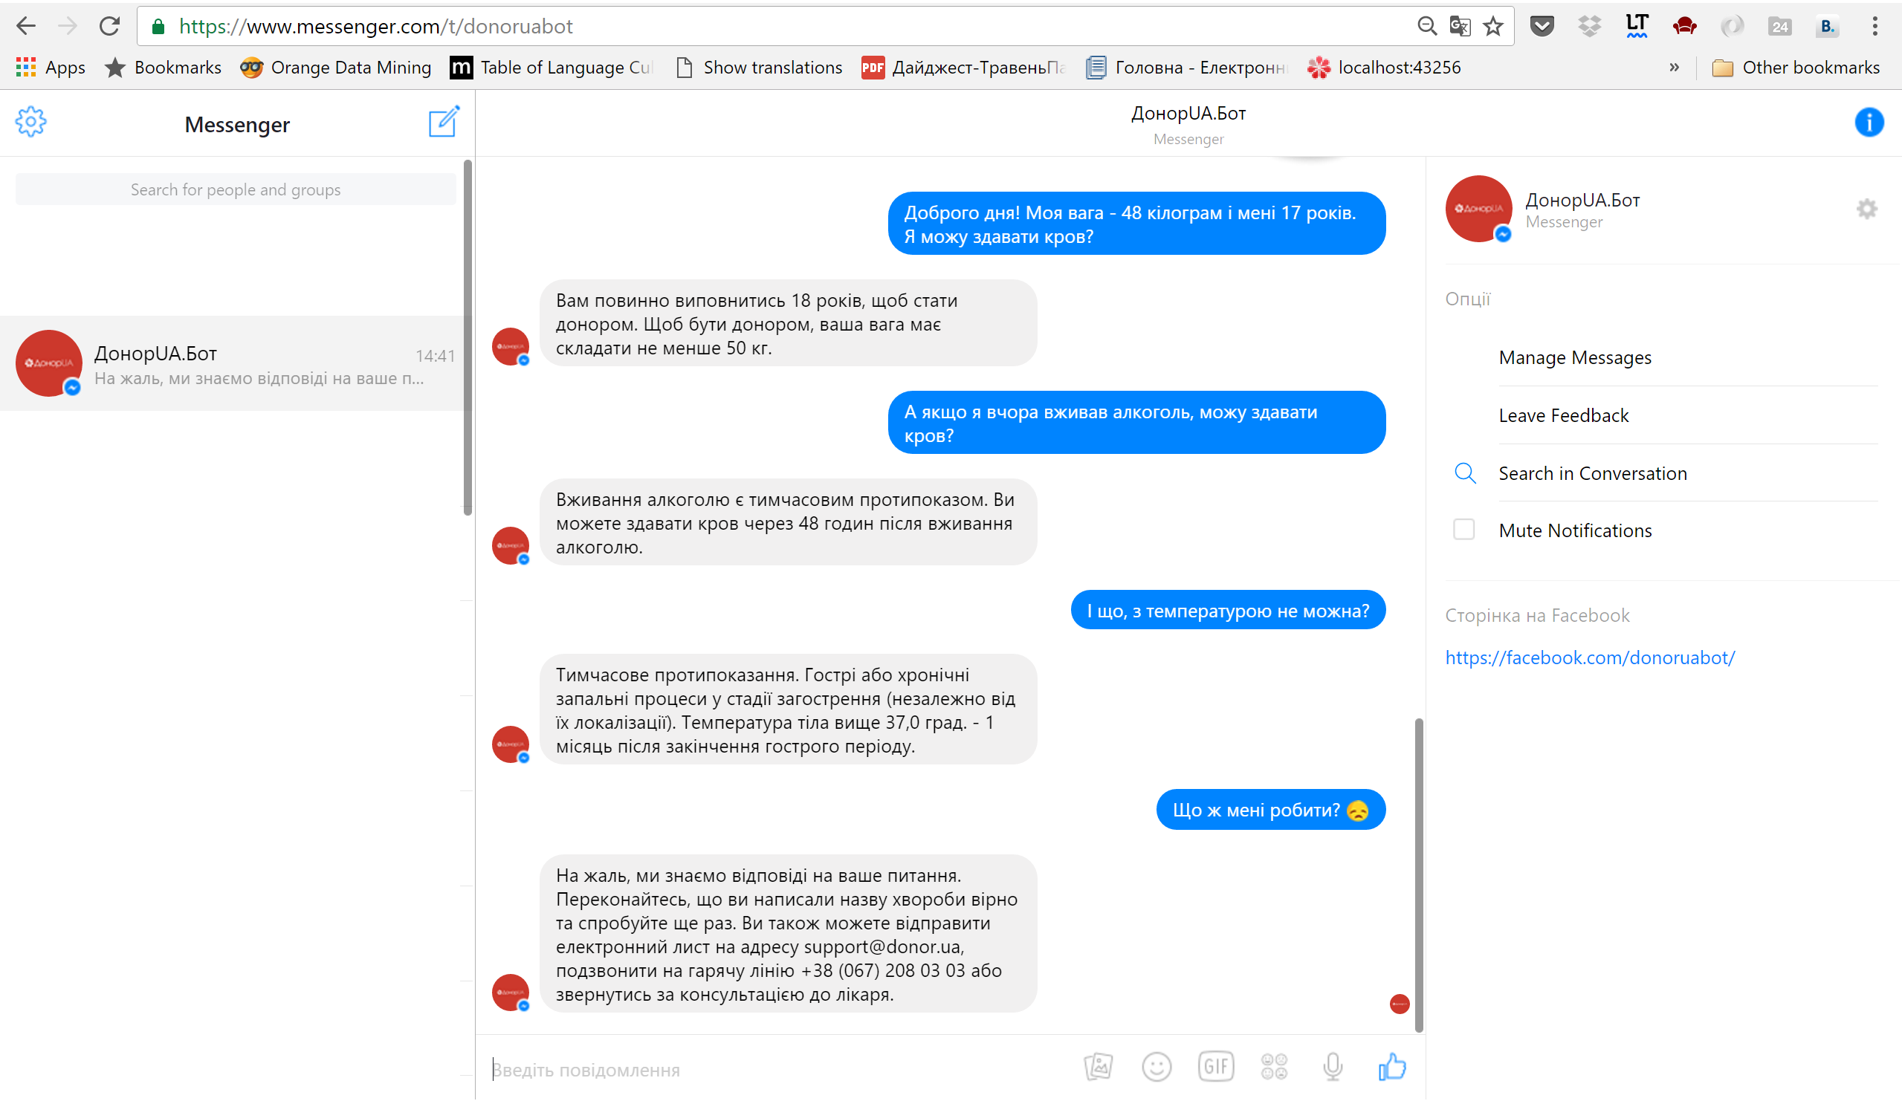
Messenger Bot

Slide 14

Contacts
info@donor.ua
alex.krakovetskiy@donor.ua
i.slavinska@donor.ua
+38 (063) 26 55 367
Skype: alex.krakovetskiy
https://www.f6s.com/udonors/
https://www.facebook.com/udonors/
http://angel.co/udonors

